Slide 1


Bean Classification
Dyson Thacker

Slide 2

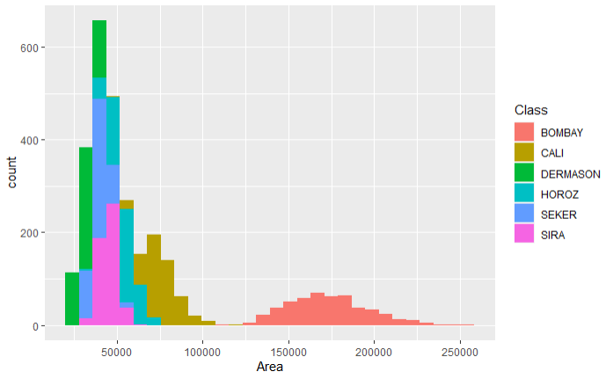
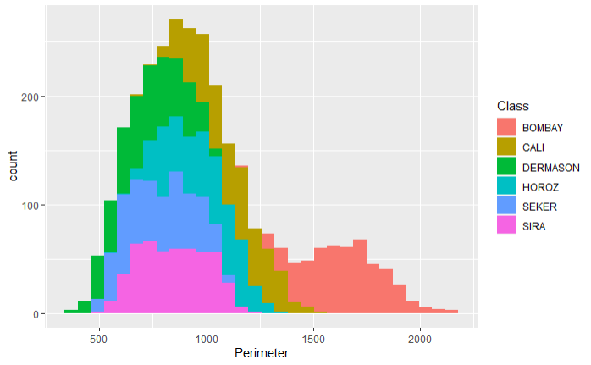
Exploratory Data Analysis

Slide 3
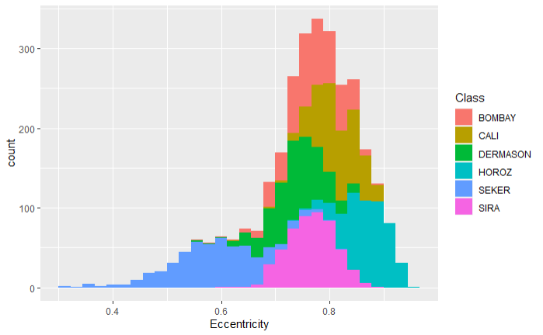
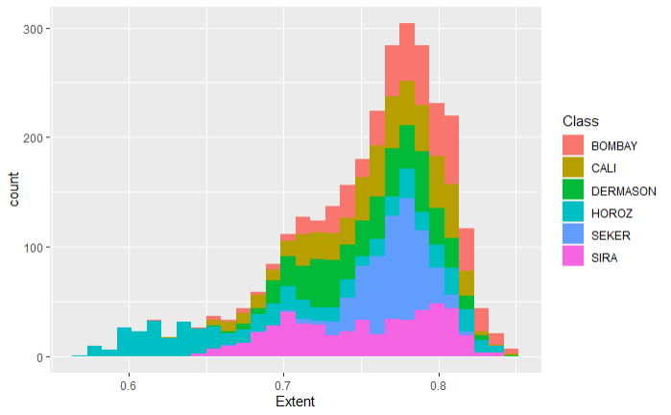
Exploratory Data Analysis

Slide 4
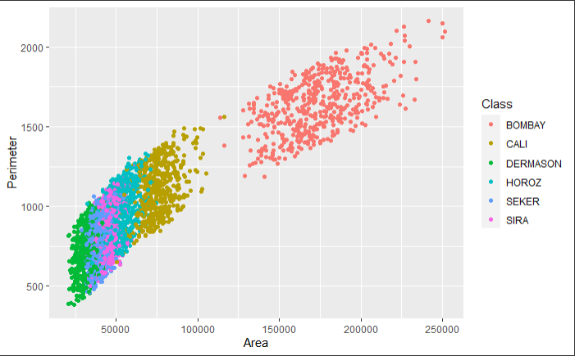
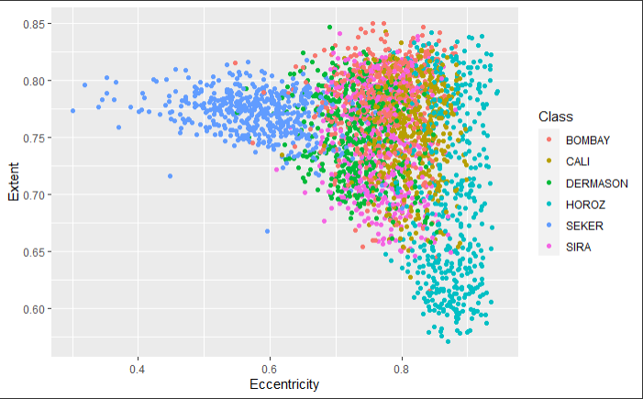
Exploratory Data Analysis

Slide 5
Predictive Models
Four models were built
Linear Discriminant Analysis
Quadratic Discriminant Analysis
Random Forest
Generalized Additive Model

Slide 6
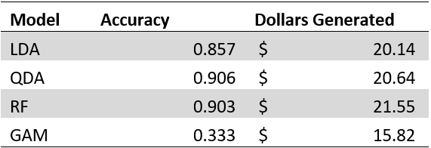
Model Selection
Using a ten-fold cross validation, QDA had the highest percent of correct predictions
Random Forest generated the most money
Better at classifying expensive beans such as Bombay, Cali, and Sira

